Slide 1
WORLD OF DRONE
Drone Components: Flight Controller Board

Slide 2
Flight Controller Board
UAV computing capability followed the advances of computing technology, beginning with analog controls and evolving into microcontrollers, then system-on-a-chip (SOC) and single-board computers (SBC).

Slide 3
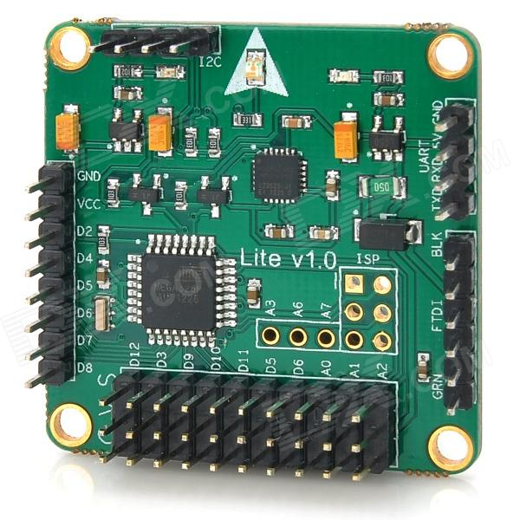
Flight Controller Board
System hardware for small UAVs is often called the Flight Controller (FC), Flight Controller Board (FCB) or Autopilot.

Slide 4
Flight Controller Board
Flight control is one of the lower-layer system and is similar to manned aviation: plane flight dynamics, control and automation.

Slide 5
Flight Controller Board
Automatic flight involves multiple levels of priority.
Some UAVs can control flight with varying flight modelisation, such as VTOL designs.

Slide 6
?
WELL DONE!
Now you can move on to the next topic...
Drone Components: Flight Stack (Autopilot Software) !

